Slide 1
ASP.NET MVC CORE
Instructor: Edwin oduor

Slide 2

Quote of the day

Slide 3
Lesson objectives
User Interface Design

Slide 4
Lesson pre-requisites
In order to take full advantage of this section you need to have the following;
Computer with Visual Studio Installed.
Stable Network Connection.

Slide 5
Training methods and extra readings
TRAINING METHODS FOR THIS LESSON
EXTRA READINGS
Lecturing Method – This is the main method of training to be adopted in this lesson with illustrations and practical coding examples.
Discussion Method - This method will be adopted periodically whereby learning will be derived principally from the students brainstorming together, rather than from the trainer. Three main types of discussions will be used:
Directed discussion
Developmental discussion
Problem-Solving discussion
Home and Learn C#

Slide 6
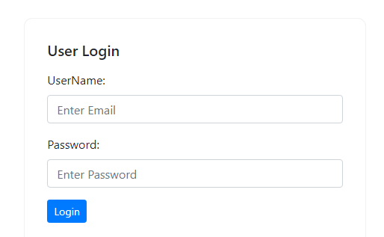
The purpose of interface design is to have an appealing interface for the user to have an a good user experience.
This is to ensure that whatever the user is seeing interests the user, to achieve this then CSS and bootstrap is going to be used to make nice looking interface for the users of the system.
The final output will look as follows, I will have screen shoots for that.
The Login Page

Slide 7
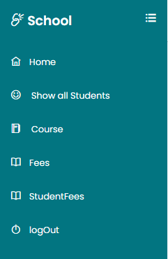
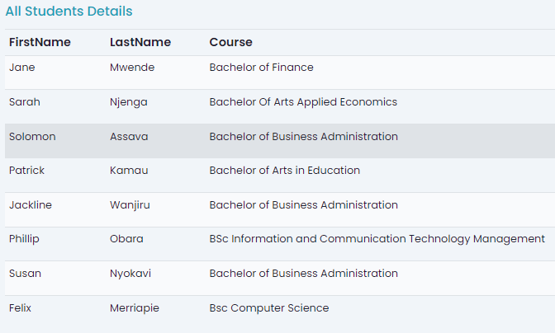
Once the user enters the correct credentials, the system will login the user.
The left side of the window we have the side bar.
On the right side after the side bar we have the main content.
Side Bar Main content

Slide 8
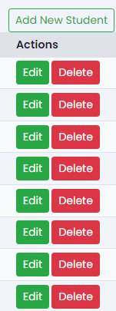
Then we have buttons for each record for editing and deleting.

Slide 9
The main aim of this session is to have our user interface look exactly as what have seen in the previous slides.

